Slide 1
Lesson 8
American Government
B: System of Government
Section: Legislative Branch
Questions: 2, 49, 50, 45, 13, 14, 17, 16, 18, 19, 20, 24, 20, 22, 21, 25, 23, 47, 33
1

Slide 2

The System Of Government

Slide 3
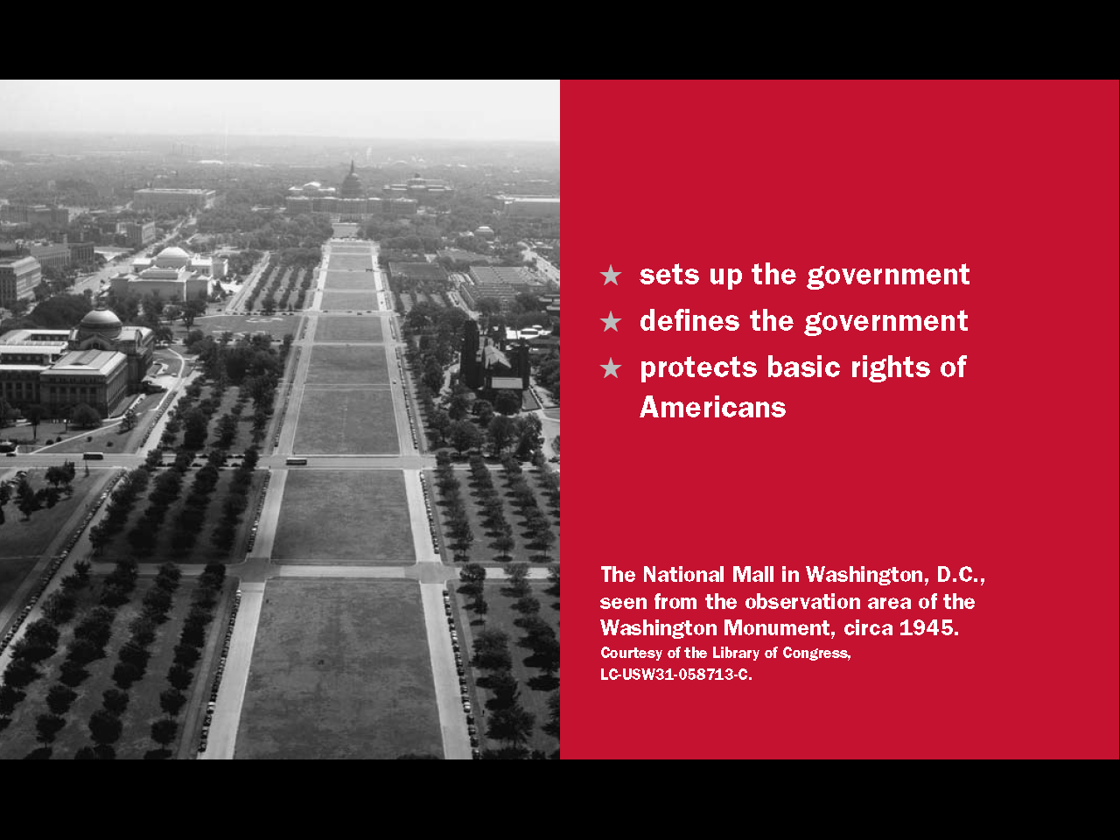
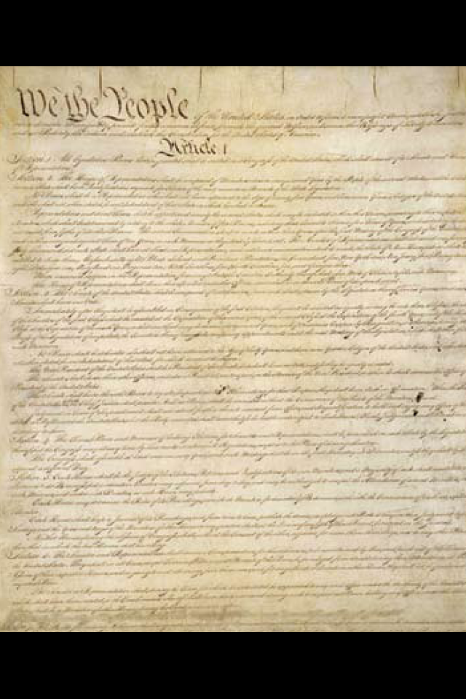
Question # 2

Slide 4
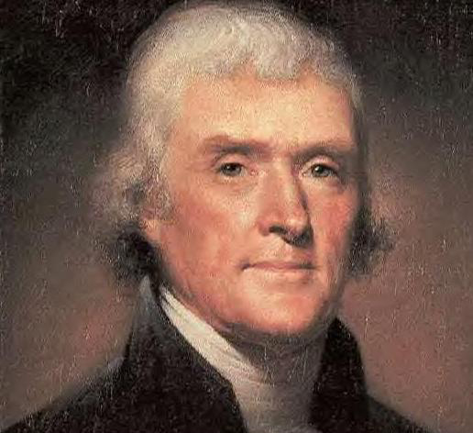
United States:
A Democratic Government
A government of the people, by the people, for the people
The way that we have a voice in our government is to vote for politicians that will represent our beliefs and opinions.

Slide 5
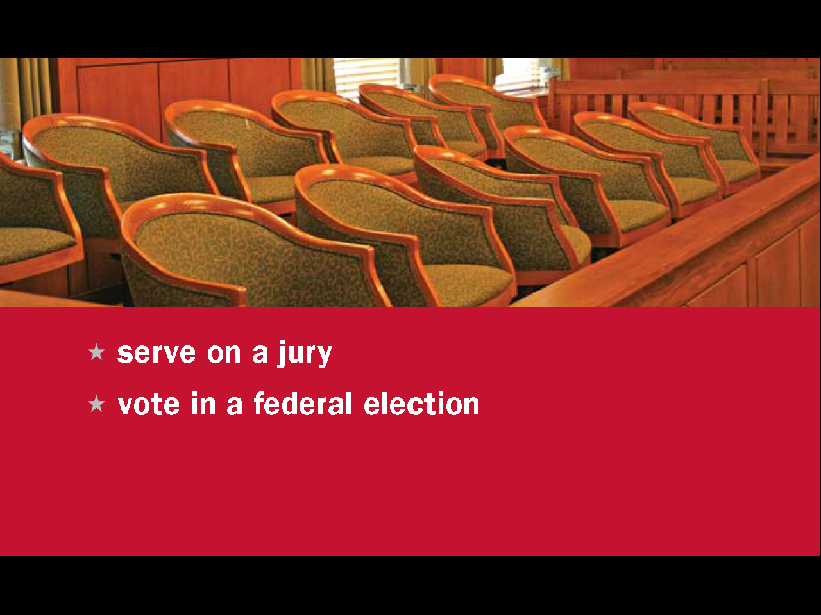

Question # 49

Slide 6

Question # 45

Slide 7


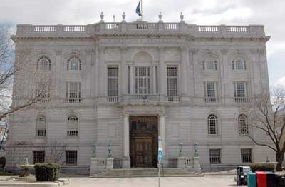
Three Levels Of Government
Federal Government
State Government
Local Government
(city, town, county)

Slide 8
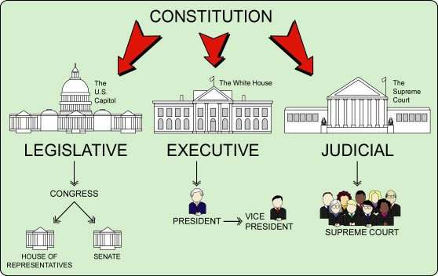
The Three Branches Of Government

Slide 9
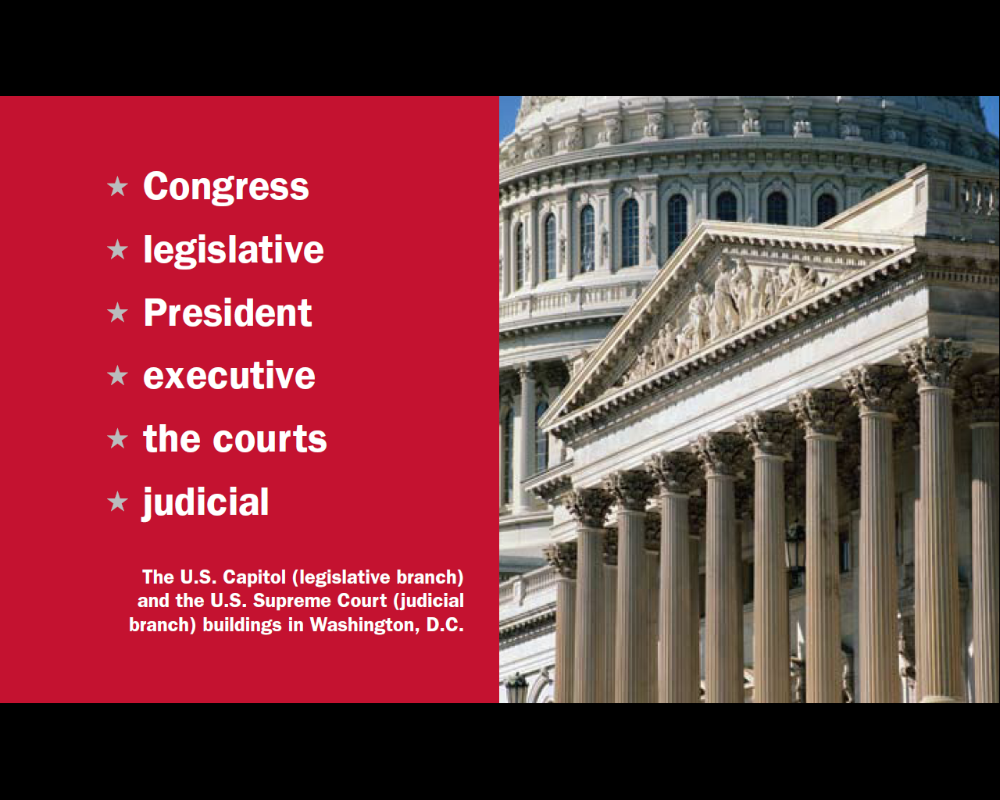
Question # 13

Slide 10
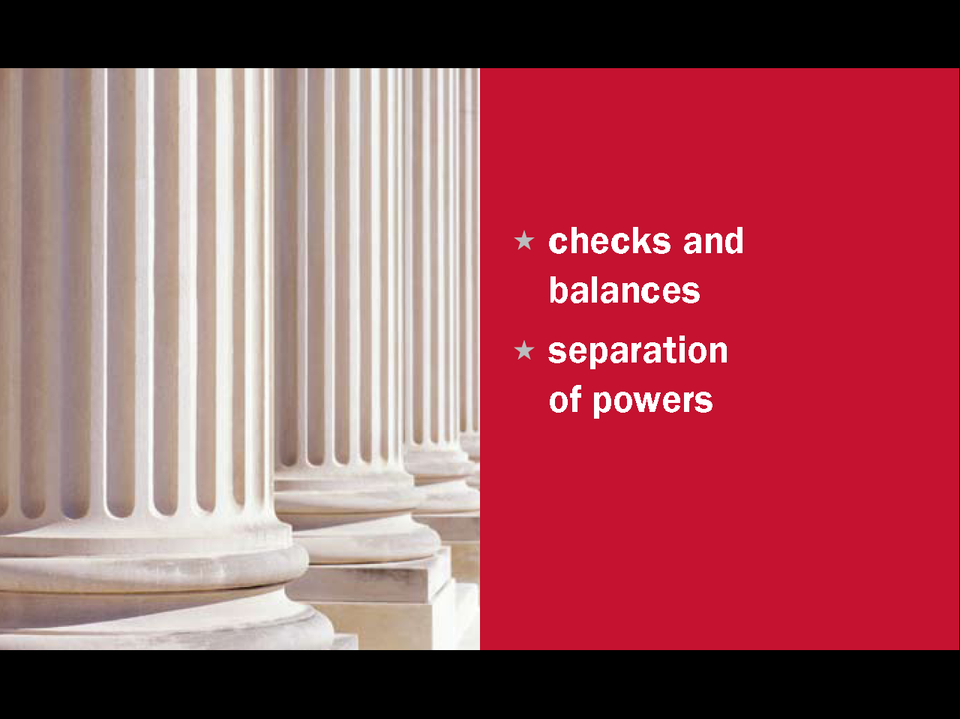
Question # 14

Slide 12
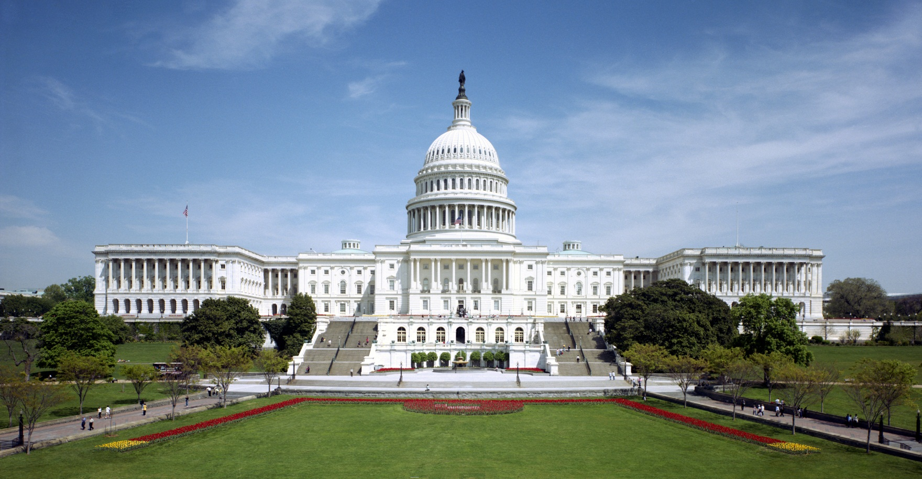
The Federal (US) Legislative Branch
The United States Capital Building, Washington DC

Slide 13
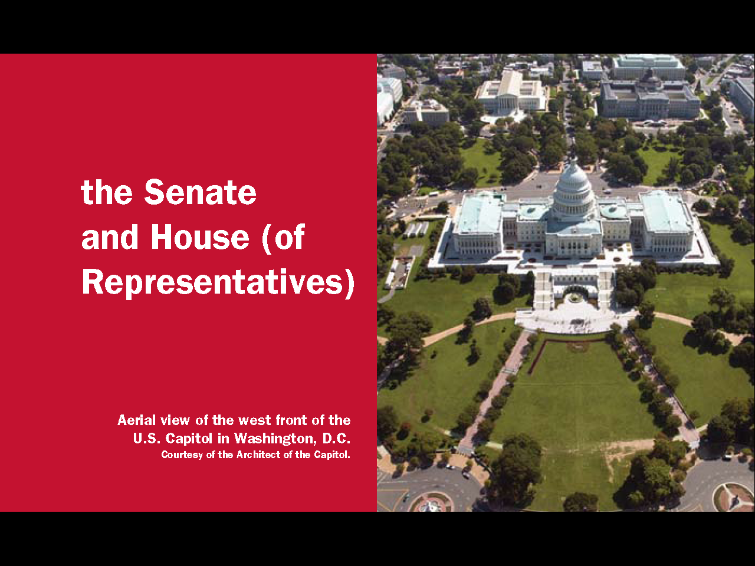
Question # 17
Senate
House

Slide 14
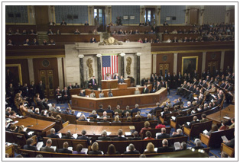
Congress Makes Laws

Slide 15
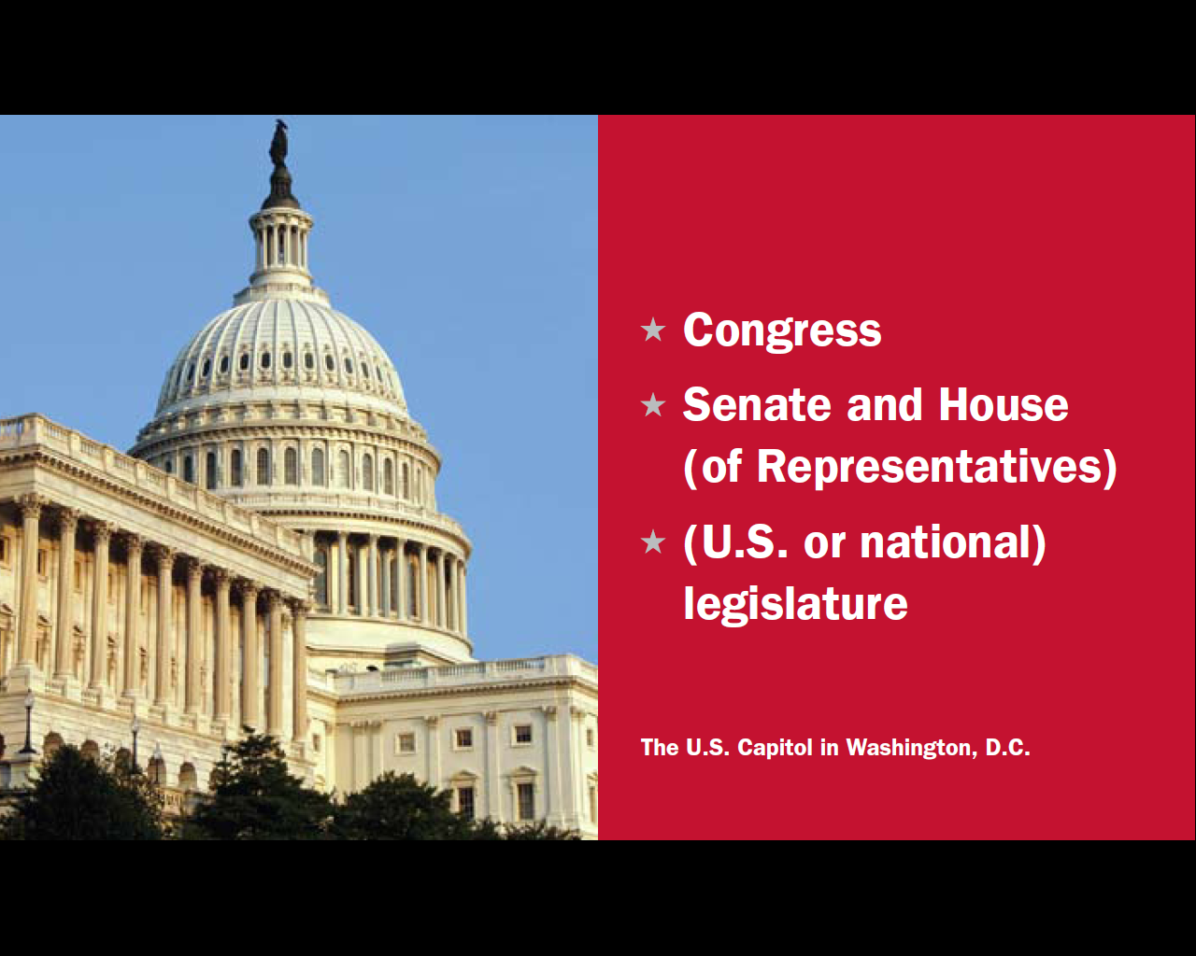
Question # 16

Slide 16


Slide 17
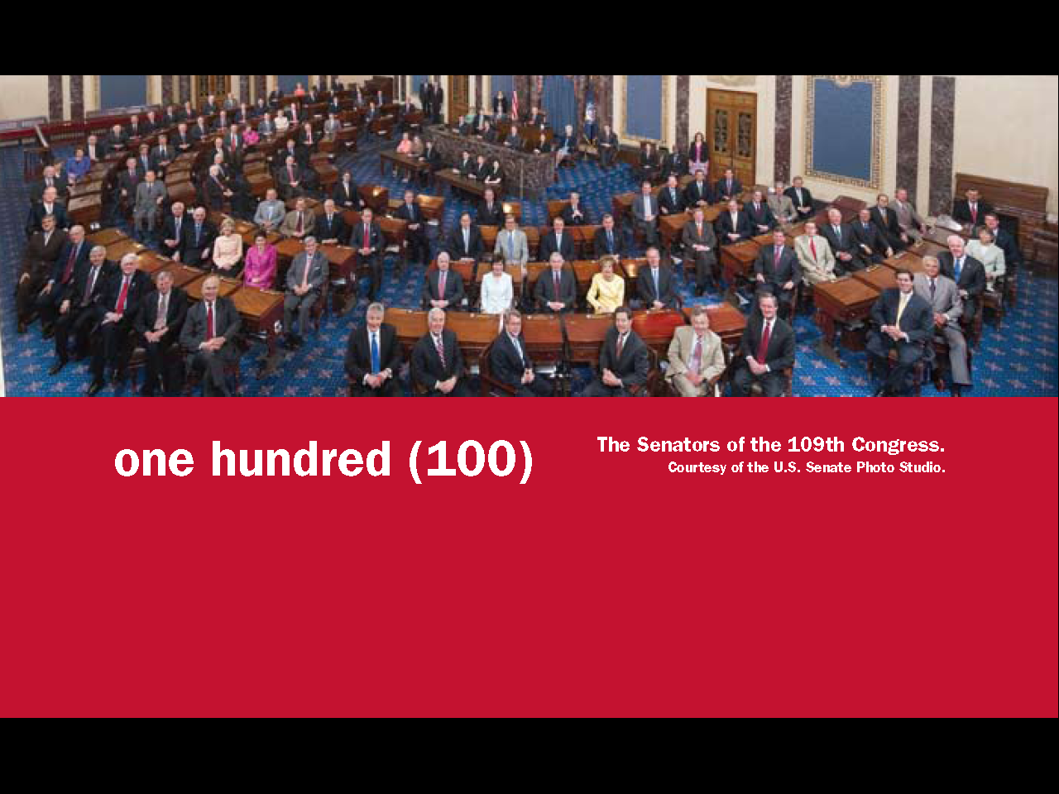
Question # 18

Slide 18
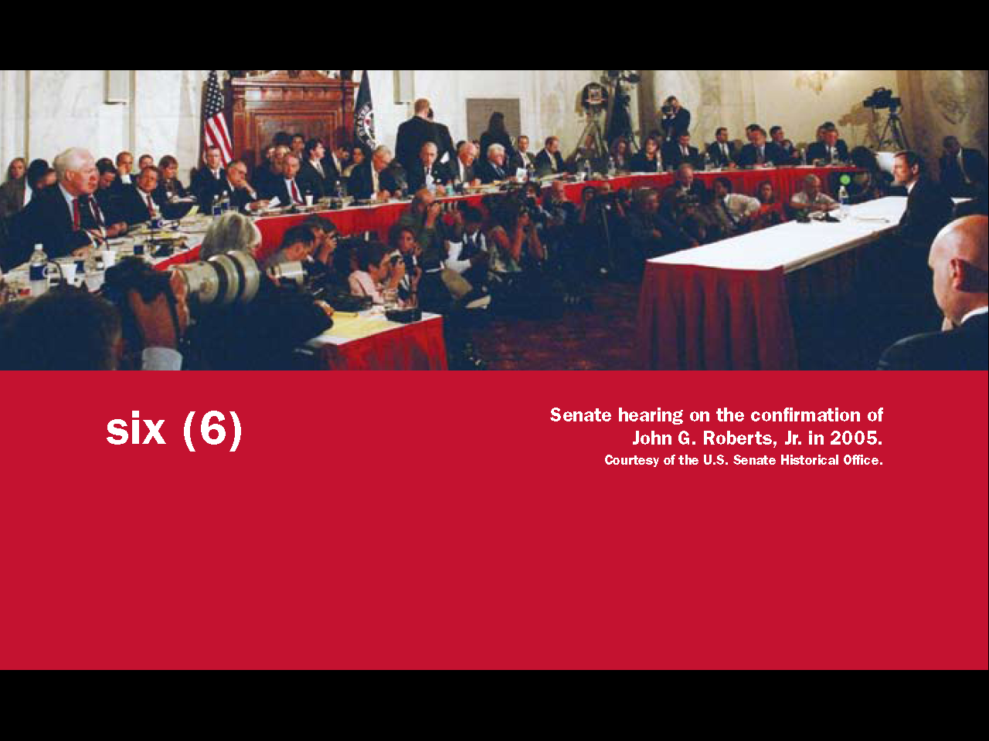
Question # 19

Slide 19

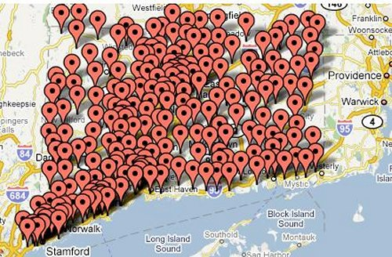
Question # 24
A United States Senator Represents
All the People Of Their State

Slide 20
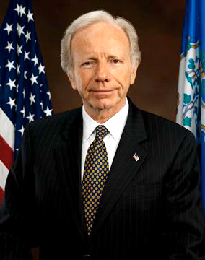
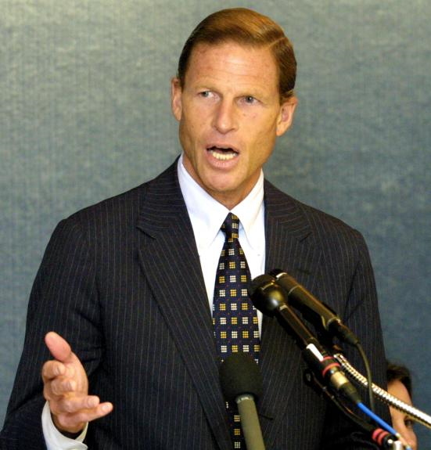
Connecticut’s 2 U.S. Senators
Question # 20
Connecticut’s 2 U.S. Senators
Joe Lieberman
Richard Blumenthal

Slide 21

Republicans and Democrats in the Senate
2008: Democrats:58, Republicans:41, Independents: 2
2010: Democrats: 51, Republicans:46,Independents:2

Slide 22


Slide 23
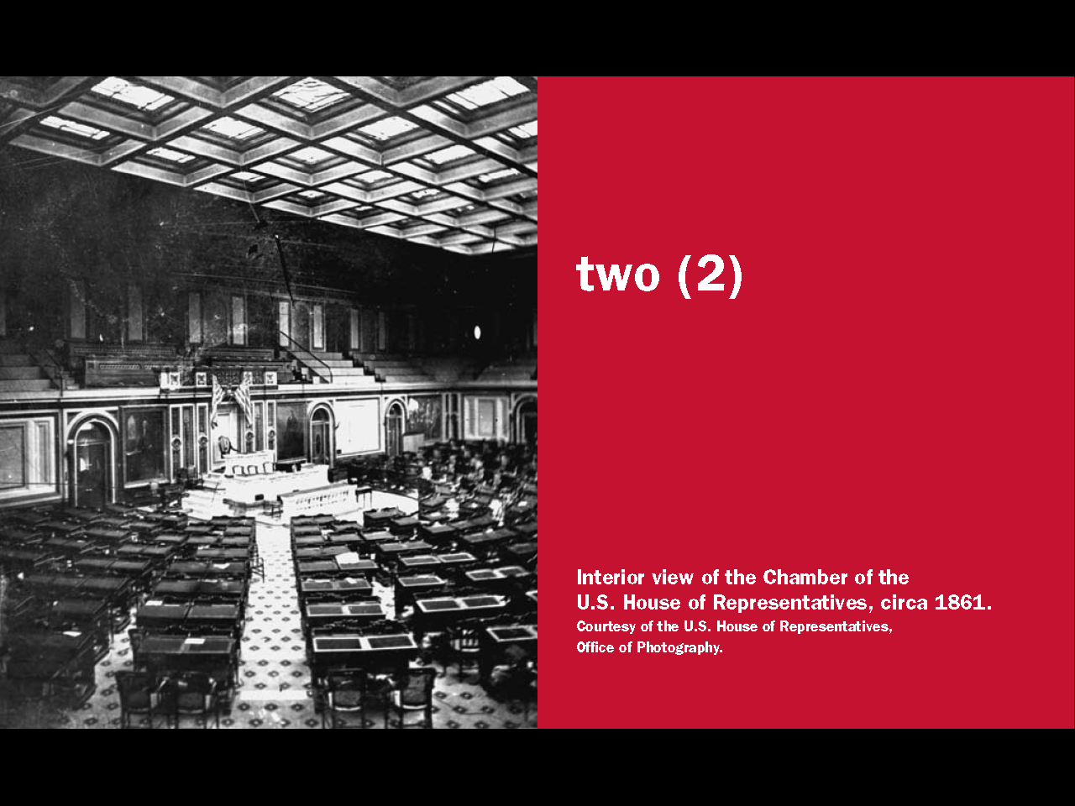
Question # 22

Slide 24
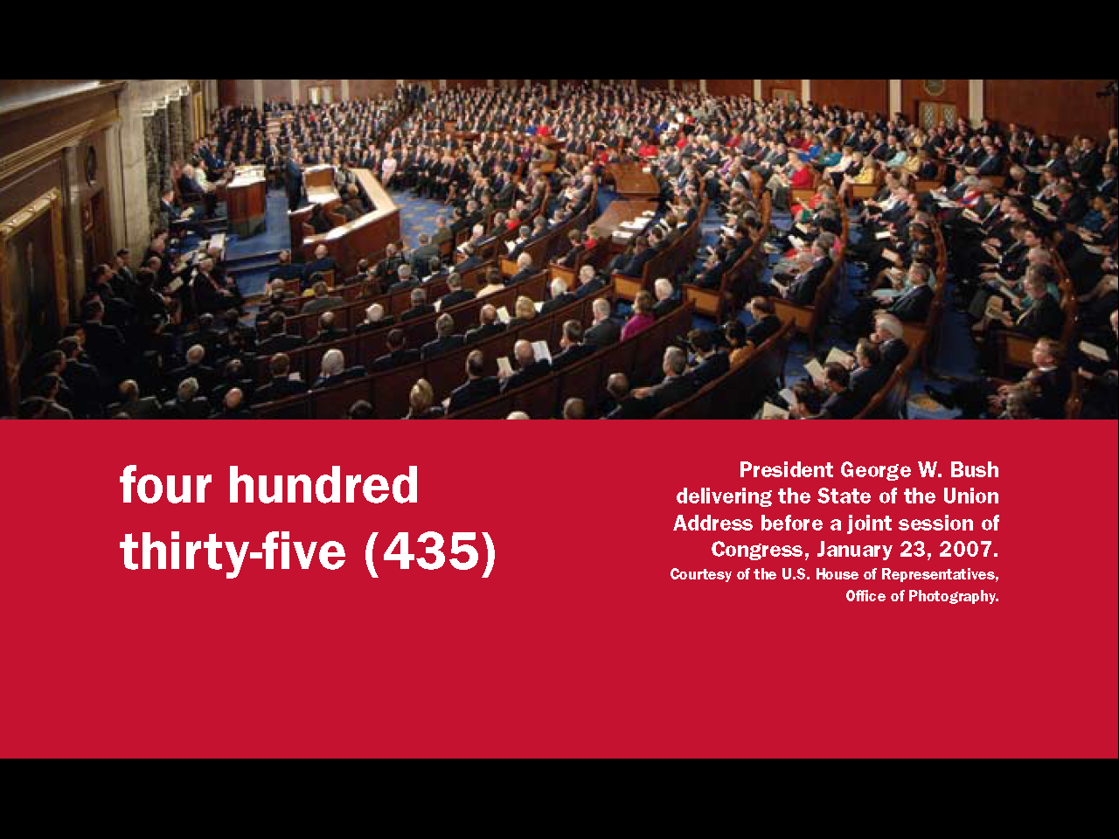
Question # 21

Slide 25
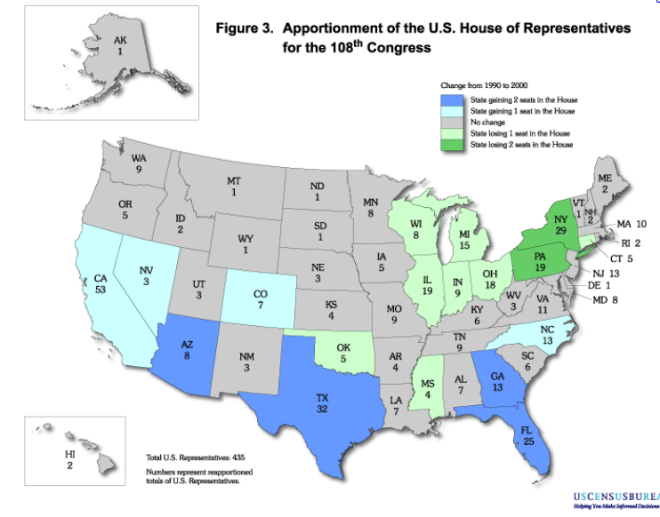
1

Slide 26
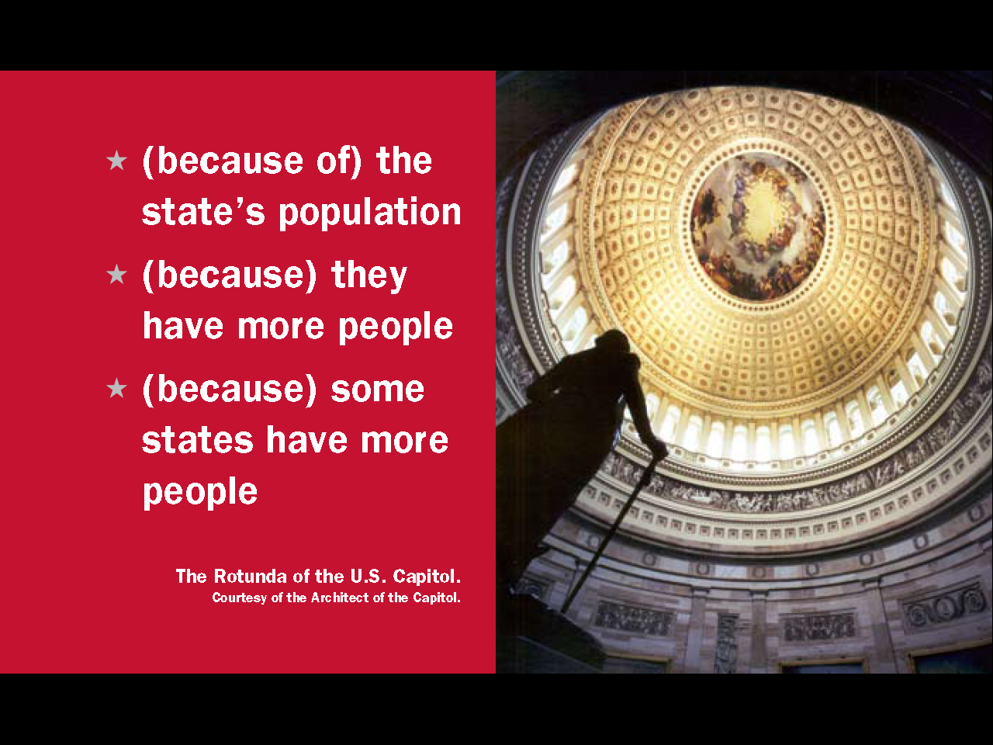
Question # 25

Slide 27
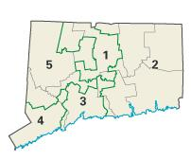
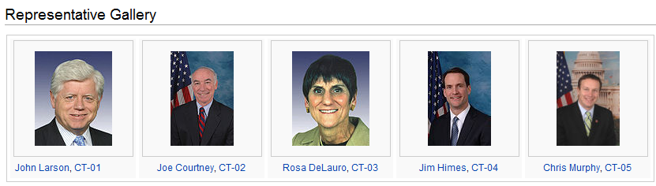
Question # 23
Hartford

Slide 28
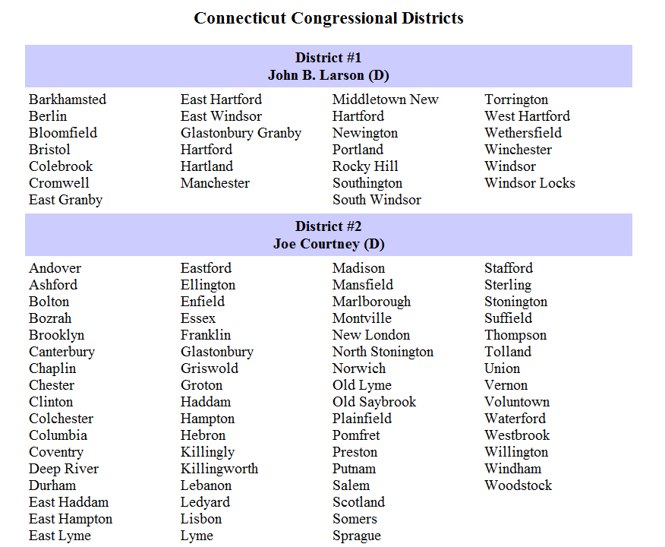

Slide 29
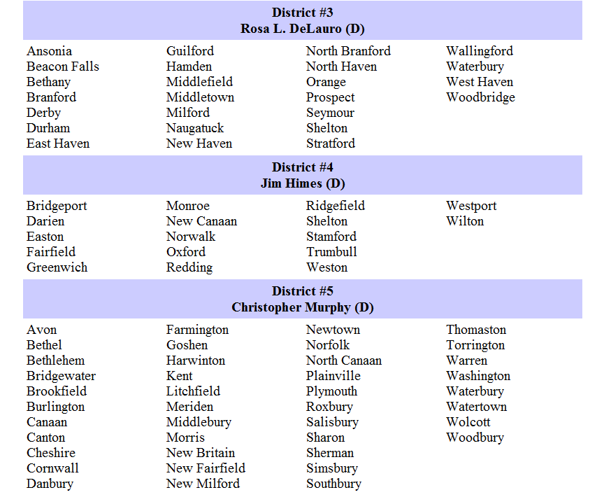

Slide 30
Republicans and Democrats in the House of Representatives
2008: Democrats: 253, Republicans: 177, Independents: 0, Vacancies: 5
2010: Democrats: 188, Republicans: 239,Independents:0, Vacancies:7

Slide 31
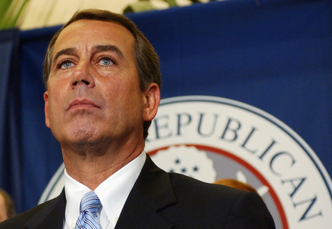
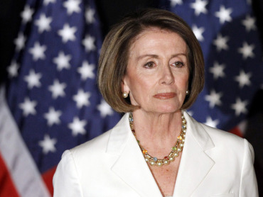
Speaker of the House
Democrat Nancy Pelosi
Republican John Boehner

Slide 32

How Laws Are Made
Patient Protection and Affordable Care Act
March 23, 2010

Slide 33


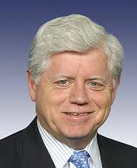
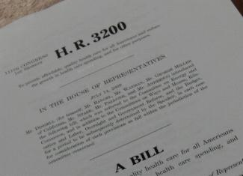

Slide 34
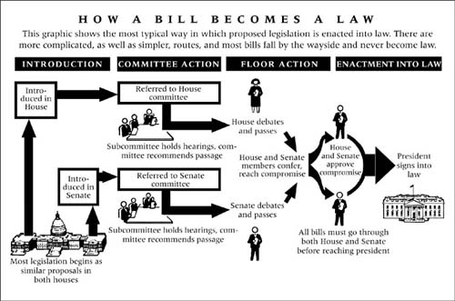
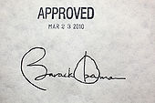
Bill introduced into the House of reps
House committee reviews and makes changes to Bill
Debates and votes
H and S approves
compromise
President Signs bill into law
H and S make a compromise between the two bills
Bill introduced into the Senate
Senate committee reviews and make changes to Bill
Debates and votes

Slide 35
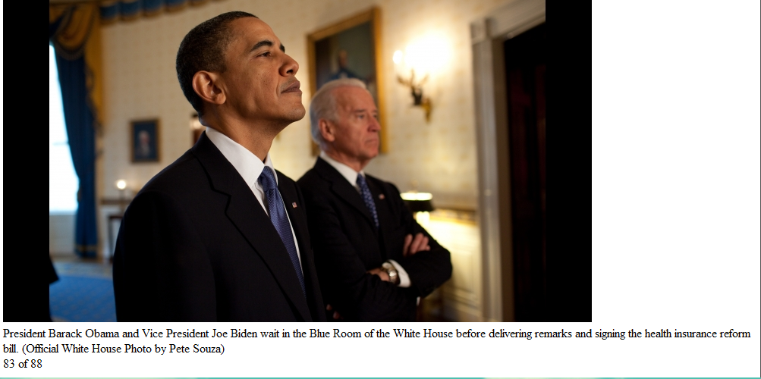
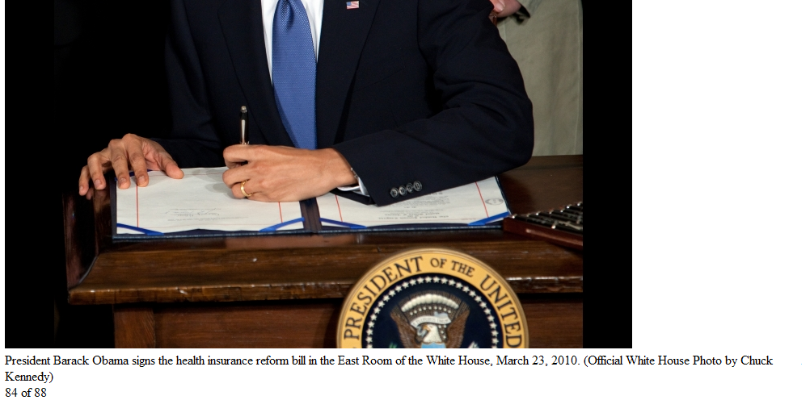

Slide 36

Question # 32-34
Question # 32-34

